Slide 1



FA-25
Lecture No.04
Course: Expository Writing
Instructor: Ms. Asma Masood

Slide 2
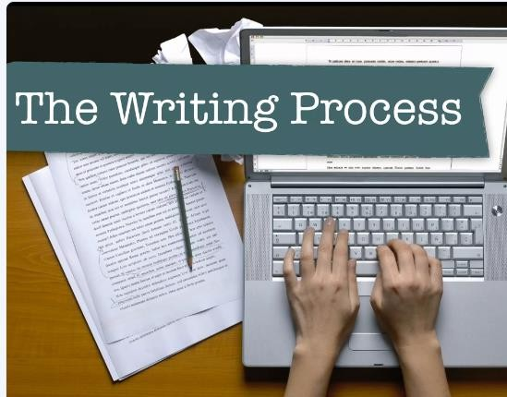
The Composition Process

Slide 3
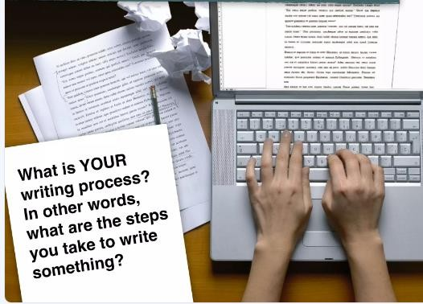
The Writing Process

Slide 4
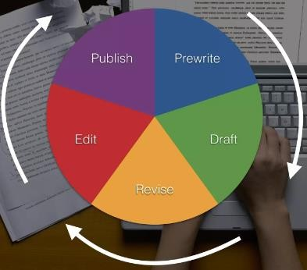
Introduction
What is the Writing process?

Slide 5
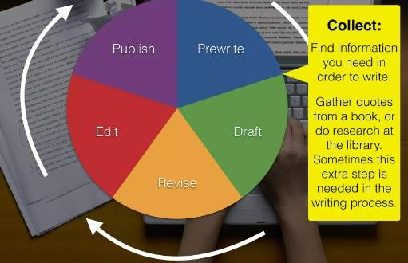
The Writing process

Slide 6
1. Prewriting
Prewriting is the initial phase of the writing process, where writers gather and organize their thoughts before drafting. It includes brainstorming, outlining, and researching to develop ideas. This stage helps clarify the purpose, audience, and main points, setting a strong foundation for effective writing.

Slide 7

Common prewriting techniques include:
Brainstorming: Generating ideas around a central topic.
Freewriting: Writing continuously without worrying about structure to explore ideas.
Listing: Creating lists of key points or themes.
Clustering/Mind Mapping: Visually organizing ideas around a central concept.
Questioning: Using questions (who, what, where, when, why, how) to deepen understanding of the topic.

Slide 8
2. Drafting
Drafting is the stage in the composition process where writers take their prewriting ideas and turn them into a rough version of their final piece. During drafting, the focus is on getting ideas down on paper in a structured form, without worrying too much about grammar, spelling, or polish.

Slide 9
Key points of Drafting
Developing Structure: Writers begin to form paragraphs, organize main ideas, and create a logical flow.
Expanding Ideas: Initial ideas from prewriting are expanded into sentences and paragraphs to build a cohesive argument or narrative.
Creating a Rough Outline: This version is flexible and may go through many changes, with content and ideas evolving as the draft progresses.
Focusing on Content Over Perfection: Drafting is about laying the foundation, so concerns about style, wording, and finer details can be addressed in later stages.

Slide 10
Revising
Revising is the process of reviewing and refining a draft to improve clarity, coherence, and overall effectiveness. In this stage, writers focus on the "big picture" of their work, rather than details like grammar or spelling (which come later in editing).

Slide 11
Editing
Editing is the stage in the writing process where the focus shifts to refining language, grammar, punctuation, and style.
Unlike revising, which deals with larger structural and content issues, editing hones in on the finer details to ensure
the writing is clear, accurate, and polished.

Slide 12
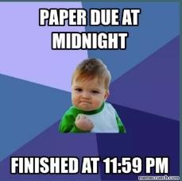
Publishing
The process of deciding that your final copy is finished and ready for your audience to read.

Slide 13
Activity: Micro Writing Process!
Students will write a short piece of writing to practice “The Writing Process”.
Prompt:
Write a story about a time when you learned something important about something. (At least 7 sentences long)

Slide 14
Prewrite
Strategy Number 1: Brainstorm List
List out everything you can think of about the assigned topic. Only use short words and phrases.
Example: Families
Parents
Types of families
  Siblings
Siblings rivalry

Slide 15
Continued…
Strategy Number 1: Brainstorm List
When your topic is broad, try breaking it down into more specific ideas.
Example: Families
The history of family formation
  How families support children
    Why families fall apart
How human families compare to animal families

Slide 16
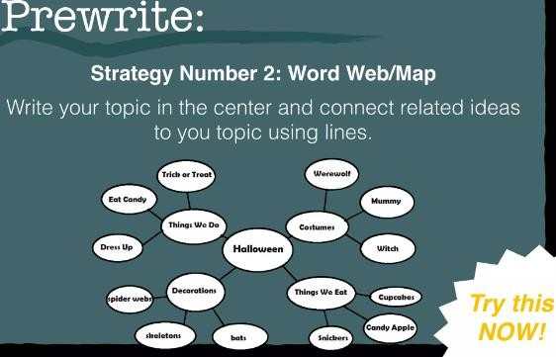
Continued…

Slide 17
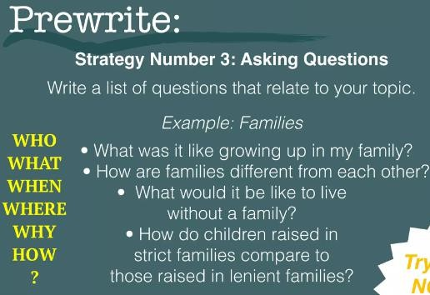
Continued…

Slide 18
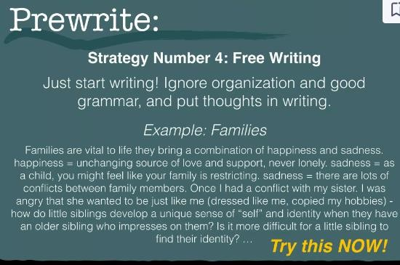
Continued…

Slide 19
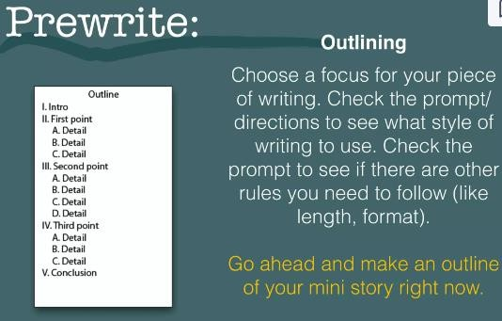
Continued…

Slide 20
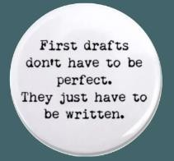
Continued…
Draft
Go ahead and write your mini story now!

Slide 21
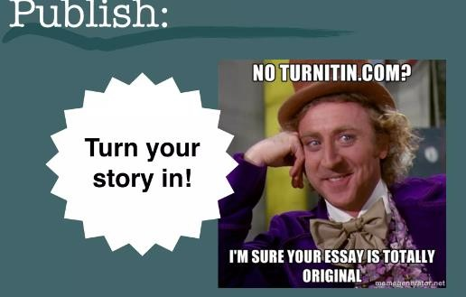
Publish

Slide 22


12/25/2024
22

